Slide 1
Dicing and Partial Dicing Release of Lithographed Device
Neuralink, US 2023/0382098, 11/30/2023 6/19/2024

Slide 2
Background
System and method for implanting devices to biological tissue described in US 2018/0296243 (“Methods, Compositions, and System for Device Implantation”)[1]
System and method for implanting devices to biological tissue described in US 2020/0086111 (“Device Implantation using a Cartridge”)
Before implanting and piercing biological tissue, need to remove electrodes from substrate (expose electrodes for implantation)
[1] This patent is NOT from Neuralink

Slide 3
Outline
Goal: Describe method for fabricating cantilever structure using partial dicing (partitioning of wafer)
Embodiments:
Method for fabricating cantilever structure
Cross-sectional views of structures fabricated with and without sacrificial layer
Cross-sectional view of substrate
Top-down views of substrate
Wafer map

Slide 4
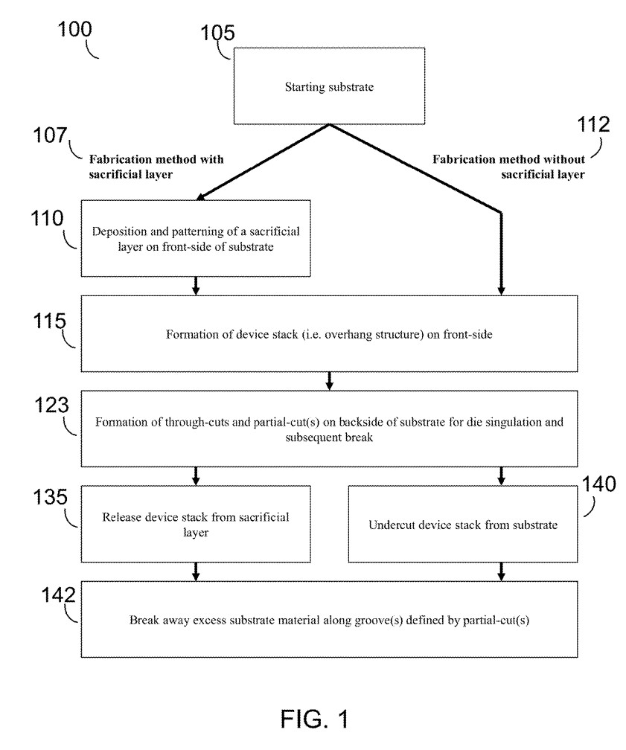
Method for fabricating cantilever structure

Slide 5
Step 1:
50 – 55 mm
8 – 15 mm
Substrate (silicon wafer)
Substrate (silicon wafer)
with sacrificial layer
without sacrificial layer

Slide 6
Step 2:
Sacrificial layer (e.g., alumninum, chromium, silicon oxide, titanium, tungsten)
with sacrificial layer
without sacrificial layer

Slide 7
Step 3:
Compliant layer (device stack) (e.g., polymide, parylene-C, SU-8 photoresist, benzocyclobutene (BCB))
with sacrificial layer
without sacrificial layer

Slide 8
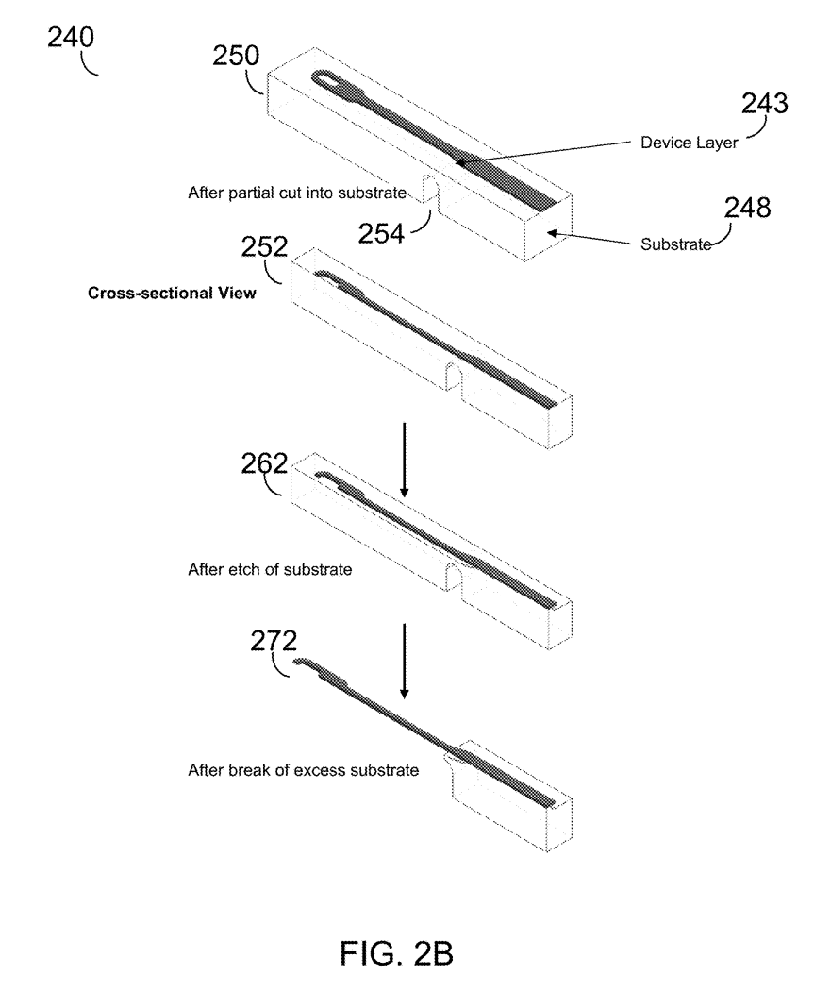
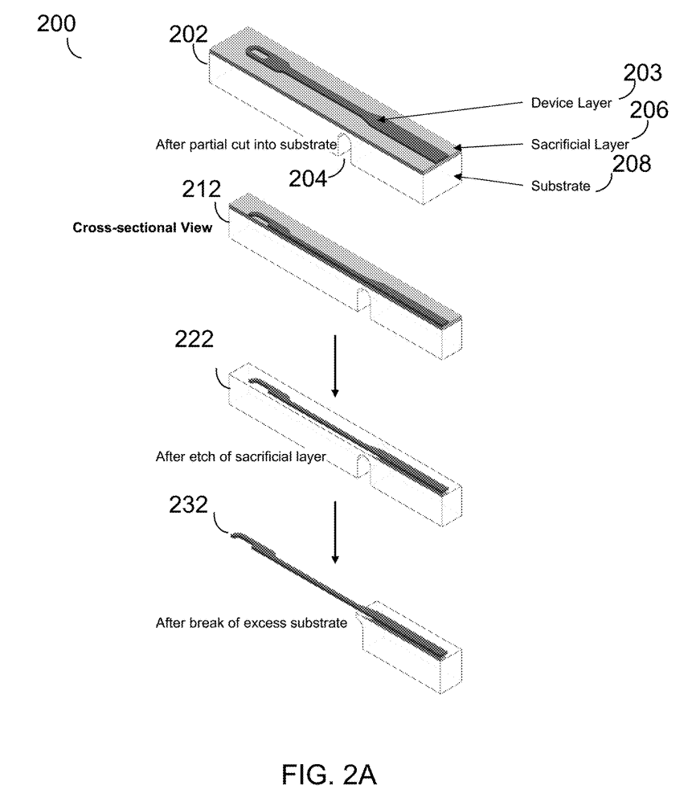
Step 4:
Partial cut on BOTTOM – done to minimize detrimental effects from dicing
(e.g., accidental damage to overhang structure, contamination)
Can make partial cuts on sacrificial layer without post-release breaking, but very difficult for thin sacrificial layers; can remove residual substrate from material from partial cut
with sacrificial layer
without sacrificial layer

Slide 9
Step 5:
Die-level processing (e.g., solvent cleans) – release device stack using wet or dry etchant
(release overhang structure AFTER partial cuts – minimize inadvertent damage to device stack & contamination)
Etchant – dilute HF, buffered HF, nitric acid
with sacrificial layer
without sacrificial layer

Slide 10
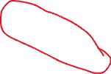
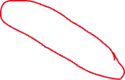
Step 6:
Break-away operation:
- Can be performed in air OR in solution;
- Can be performed manually (tweezers/forceps) or automated (impulse bar & fixturing)
with sacrificial layer
without sacrificial layer

Slide 11
Cross-sectional views of structures fabricated with sacrificial layer
Steps 4-6 above

Slide 12
Cross-sectional views of structures fabricated without sacrificial layer
Steps 4-6 above

Slide 13
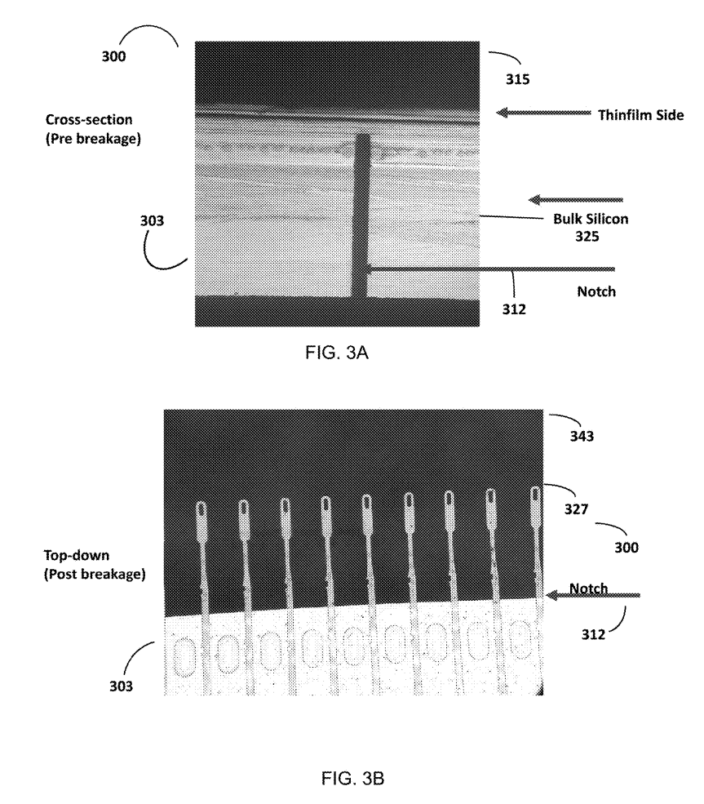

Cross-section view of substrate
Silicon wafer substrate
(aka partial cut)
Made from partial saw-and-break method
Die portions MUST be separated to ensure device integrity
Partial saw blade: 50 - 254 microns (10 mils), cut 85-99% of substrate
Full cut: 100% through substrate, 10-mil or smaller saw blade

Slide 14
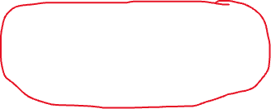
Top-down view of substrate
Free space
Exposed electrodes
(exposed to allow robot to implant)

Slide 15
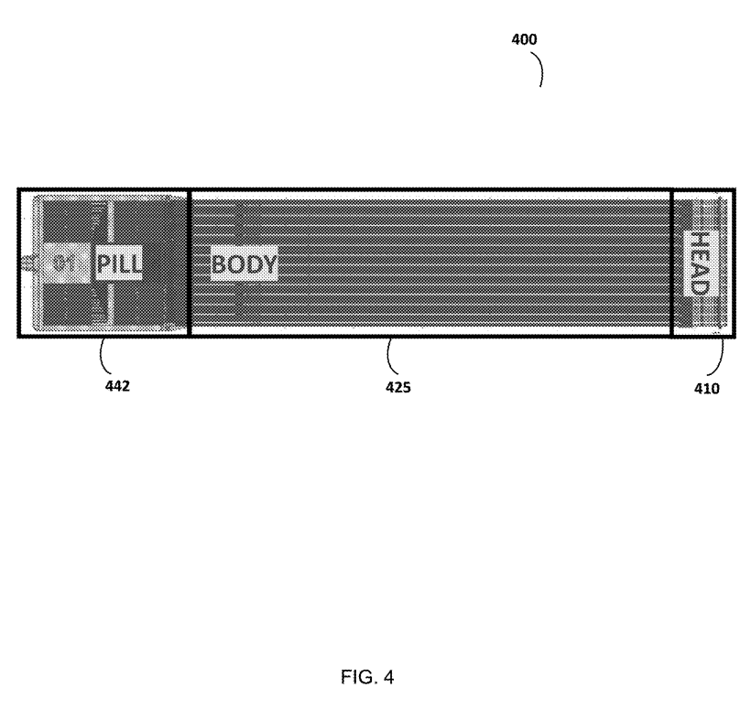
Top-down view of substrate
Pill
(Electrochemical testing)
Body
(Peel force management)
Head
(thread management / facilitating implantation;
hold array of threads / electrodes)

Slide 16
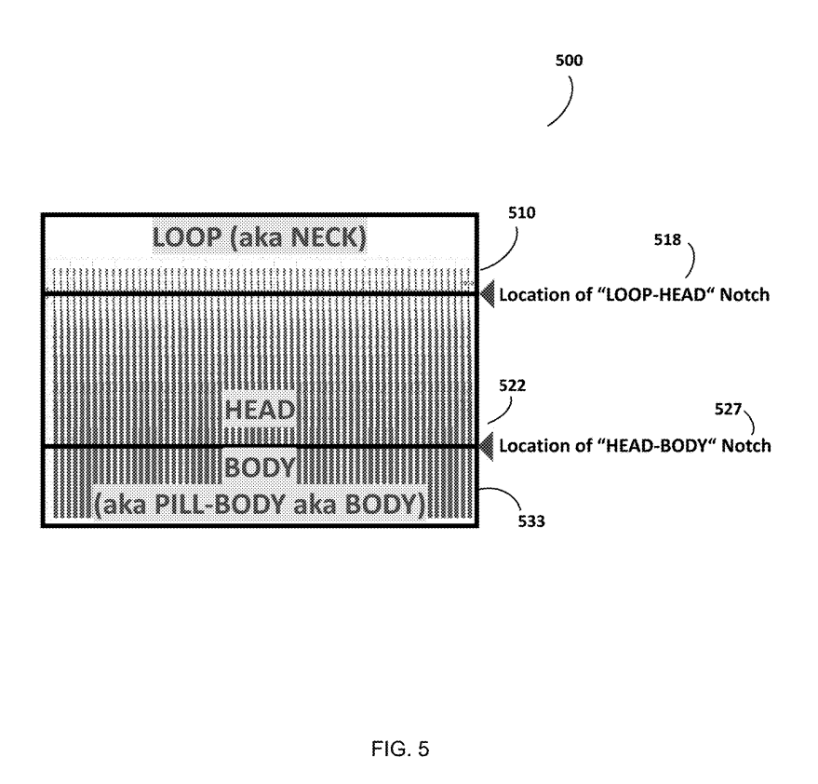
Top-down view of substrate
Maintain aluminum release layer:
Dice singulate arrays
Etch aluminum
’Snap’/break the neck
→ Device (PI) “floating” (NOT on silicon) due to aluminum underneath etched away
Threads – NOT bent during breaking

Slide 17
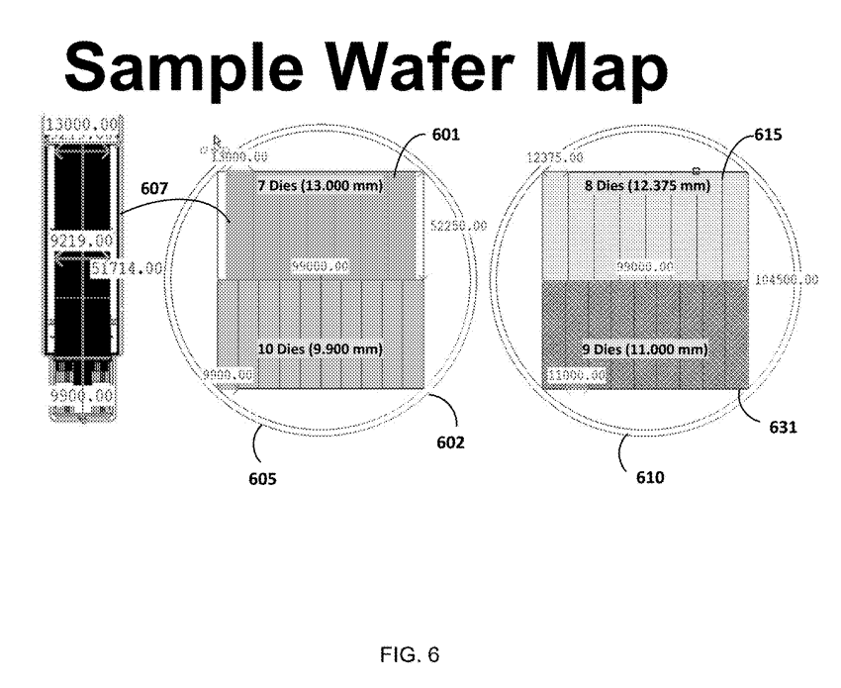
Sample Wafer Map
Enlarged die
(shows more detail)
each
mm
Wafer map
Wafer map

